Slide 1
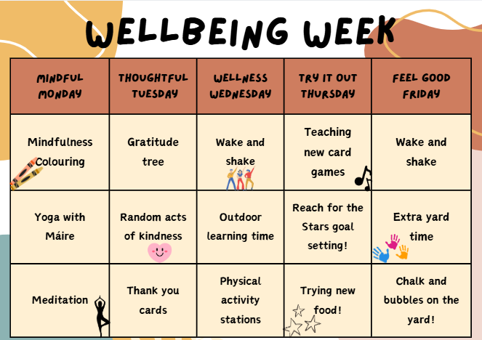

Slide 2
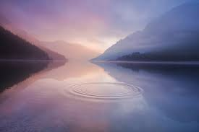
Mindful Monday
“ You create your own calm.”

Slide 3

Calming Music for Mindfulness Colouring

Slide 4

Guided Meditation

Slide 5
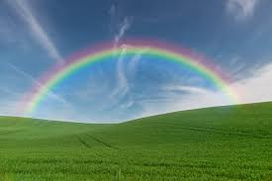
Thoughtful Tuesday
“ Be the reason someone smiles today!’’

Slide 6
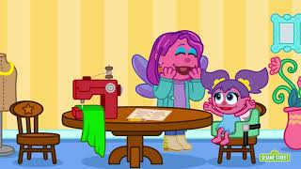
Gratitude Video (infants-2nd)
What are you thankful for?
Draw it on a leaf to be added to our school’s gratitude tree!

Slide 7

Gratitude Video (3rd-6th)
What are you thankful for?
Draw it on a leaf to be added to our school’s gratitude tree!

Slide 8

Colour/design/ write a thank you card for someone you are thankful for!

Slide 9


Slide 10
Wellness Wednesday
“Be kind to your mind!”

Slide 11
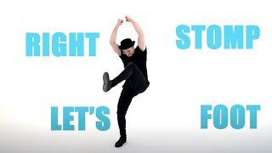
Wake and Shake

Slide 12
Try it Out Thursday
“ Believe you can and you’re halfway there!”

Slide 13

Reach for the Stars!(senior classes)
Challenge yourself!
Draw/write on a star something new you would like to try or something you would like to achieve before the end of the school year!

Slide 14
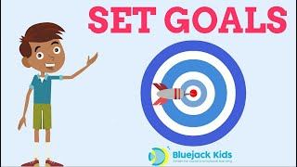
Goal Setting

Slide 15

Fun Friday
“ Always believe that something wonderful is going to happen!”

Slide 16

Wake and Shake

